Slide 1
Drug Analysis: Side Effects & Clinical Insights Exploratory data analysis of Drug Safety and Usage Patterns
RAMPRASAD M

Slide 2
Project analysis slide 2
OBJECTIVE
Analyze distribution of drugs across medical conditions
Identify common side effects
Evaluate prescription patterns (Rx vs OTC)
Explore drug classes and clinical relevance
Assess safety factors (alcohol, pregnancy, severity)
DATASET OVERVIEW
Total records: 2931 drugs
Variables: 17 columns (drug name, condition, side effects, rating, etc.)
Key missing data:
Alcohol interaction
Ratings & reviews
Data cleaning performed for consistency

Slide 3
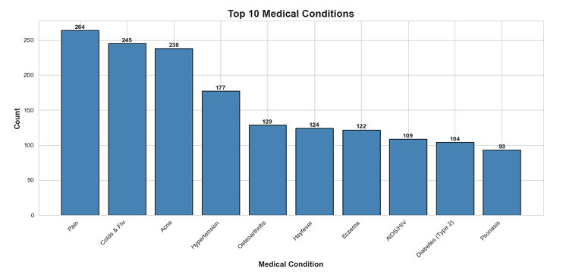
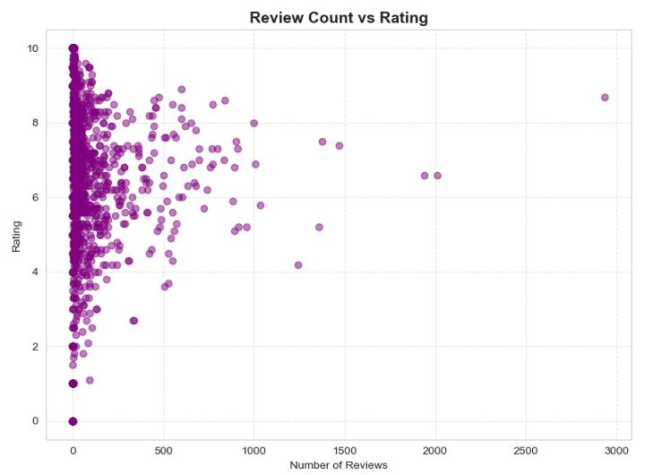
Project analysis slide 6
KEY INSIGHTS
Top Medical Conditions
Pain, Cold & Flu, Acne are most common
Indicates high prevalence of symptomatic treatments
Chronic conditions also significantly represented
Review Count vs Drug Rating
Majority of drugs have low review counts (<200)
Ratings are mostly between 5–9 range
No strong linear relationship between reviews and rating
Higher review counts tend to stabilize ratings, indicating consistent drug performance across larger patient populations.

Slide 4
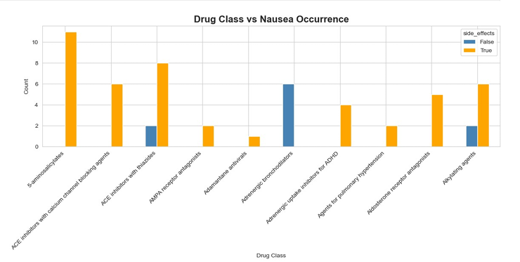
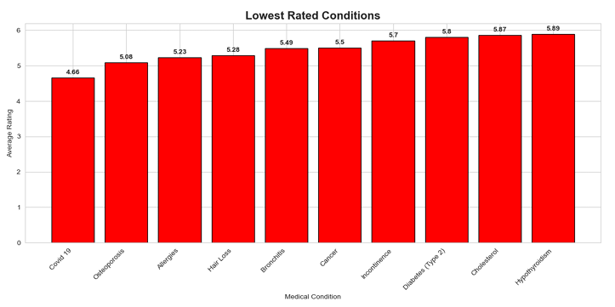
Project analysis slide 6
KEY INSIGHTS
Drug Class vs Nausea Occurrence
Gastrointestinal side effects are class-specific
This indicates that adverse effects like nausea are not random but linked to specific pharmacological classes, helping in safer drug selection.
Lowest Rated Medical Conditions
Conditions like: COVID-19, Osteoporosis , Allergies show lower average ratings
Ratings range approximately 4.6 – 5.9
Lower ratings suggest:
Reduced treatment satisfaction
Possible variability in drug effectiveness
Need for improved or personalized therapies

Slide 5
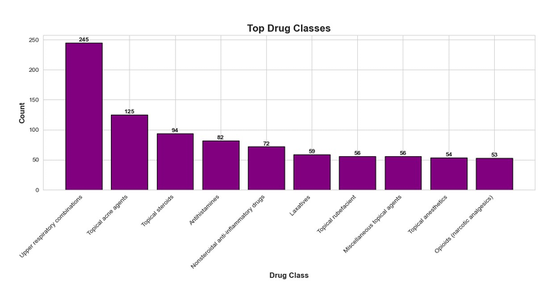
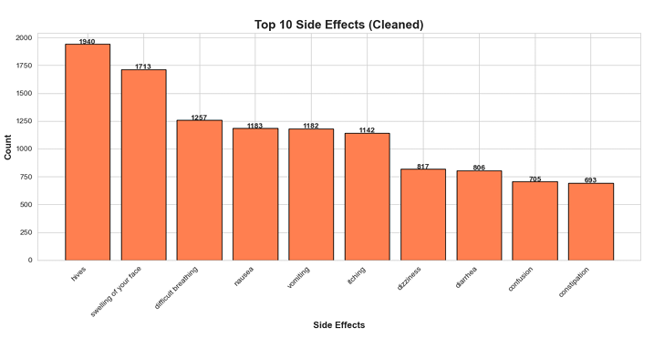
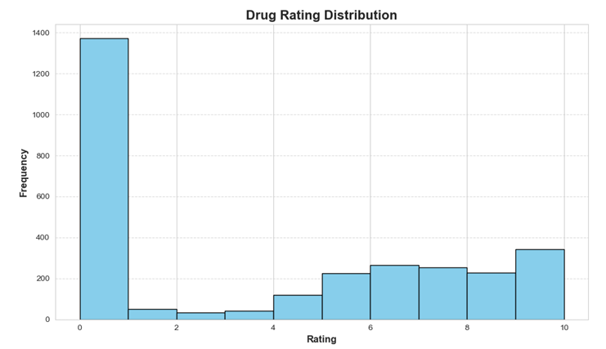
Project analysis slide 6
KEY INSIGHTS
Side Effects & Drug Classes
Common side effects:
Hives, swelling, breathing difficulty
Indicates hypersensitivity reactions
Major drug classes:
Respiratory, dermatological, anti-inflammatory
Rating & Effectiveness
Most drugs show moderate–high ratings
Variation suggests: Patient response differences
Disease complexity
Some conditions show lower satisfaction → unmet needs

Slide 6
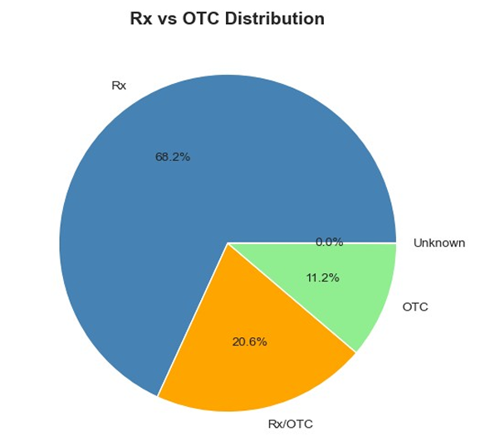
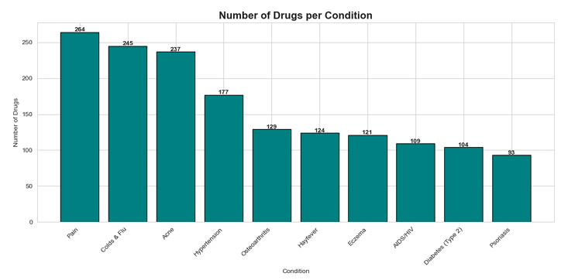
KEY INSIGHTS
Prescription vs OTC Drug Distribution
Most treatments require medical supervision, reflecting the importance of controlled prescribing due to potential risks and adverse effects.
Number of Drugs per Medical Condition
Pain has the highest number of available drugs (~260+)
Chronic conditions like: Hypertension, Osteoarthritis have moderate treatment options
The availability of multiple drugs for common conditions like pain and acne indicates high treatment demand and variety in therapeutic options. In contrast, fewer drugs for certain conditions may reflect limited treatment choices or specialized therapies.

Slide 7
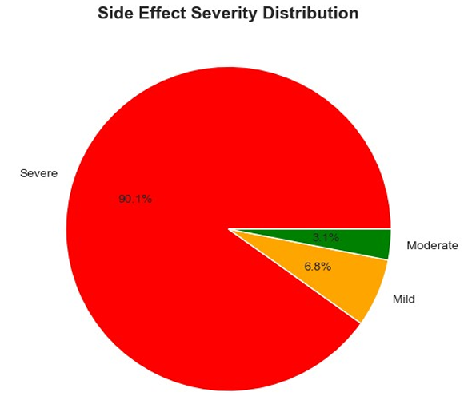
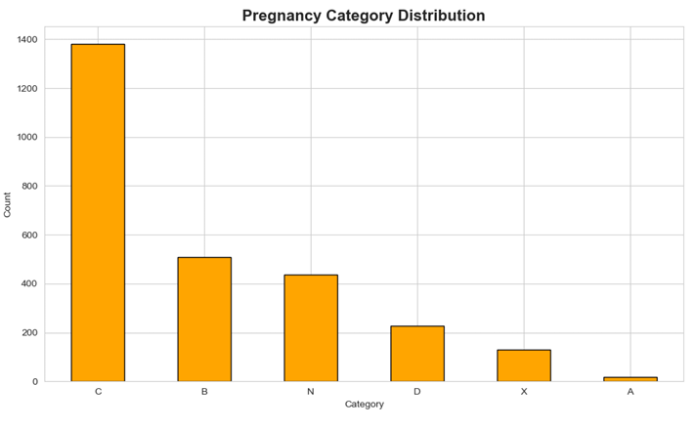
KEY INSIGHTS
Safety Analysis
Alcohol interaction data largely missing → limitation
Pregnancy categories: Majority in C and B
Severe side effects (breathing/swelling) are significant
Emphasizes need for monitoring

Slide 8
Project analysis slide 7
CONCLUSION
Drug usage patterns reflect common clinical conditions
Allergic and systemic side effects are prominent
Prescription drugs dominate treatment
Safety concerns (pregnancy, alcohol, severity) are critical
Data-driven insights can improve:
Clinical decision-making
Patient safety

Slide 9
Thank You

